Slide 1
EDA of IPL dataset

Slide 2
Introduction
Context: Performance of players in IPL can be accessed by using various features like runs, sixes, age etc. during their cricket career which drives their pricing in Indian Premier League.
Data source : Wiley India Website ^{[Link]}
About the Dataset:
Sample Size: 130 data points and 26 features.
No missing values.
Statistical Tools used: Used Python to perform EDA and data visualization.
Notes:
The performance of the players could be measured through several metrics. Although the IPL follows the Twenty20 format of the game, it is possible that the performance of the players in the other formats of the game such as Test and One-Day matches can influence player pricing

Slide 3
Analysis and Output(1/5)
Country wise % of players
Players Age profiling
We find 40% players are from India followed by 16% from Australia and 12% from South Africa.
The 3 players who are sold at lowest price are Nofke, AA, Kamran Khan, Abdulla,YA and highest are Swhwag,V, Yuvraj Singh and Kohli, V.
We find most players lies in the second age group, bowlers having largest count of 29.
Last five lowest sold players
Top 5 highest selling players

Slide 4
Analysis and Output(2/5)
Plots to show the same
We find average selling price for lower age band players is highest.
In age band 1 and 2 we find batsman having selling price more than average for that band but for age group 3 all rounder tops.
Top 3 Players with who hit most sixes are C. Gayle, Gilchrest, Pathan.
Age and Playing role wise sold price compared with average
Age band 1
Age band 2
Age band 3

Slide 5
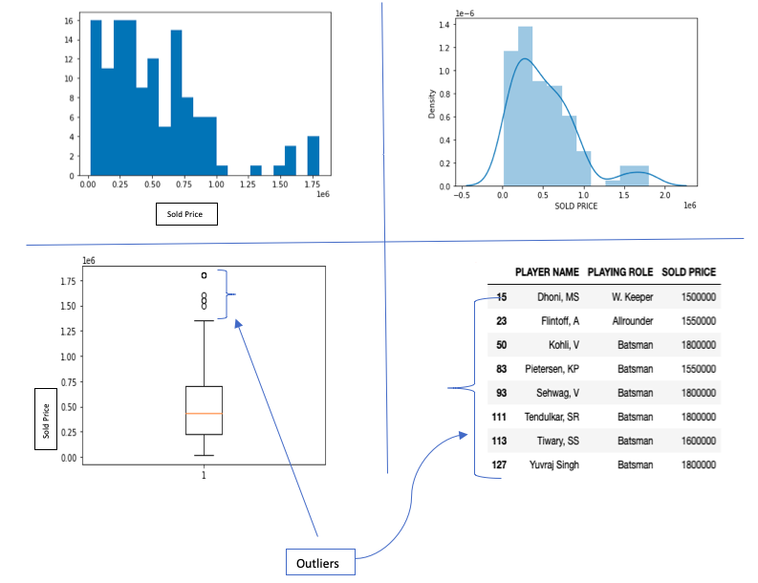
Analysis and Output(3/5)
We find the distribution of sold price is right skewed.
There are outliers with high selling price like Dhoni MS, Flintoff A., Kohli V, etc.
The distribution statistics:
Max: 13,50,000
Min: 20,000
Q1: 2,25,000
Q2 or Median: 4,37,500
Q3: 7,00,000
IQR: Q3-Q1= 4,75,000
Outliers are beyond 1.5IQR i.e. players sold price greater than 13,50,000

Slide 6
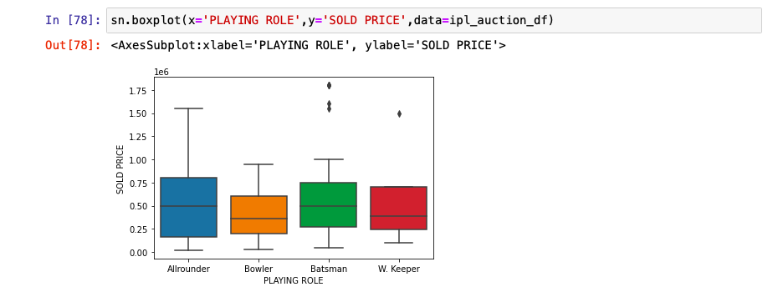
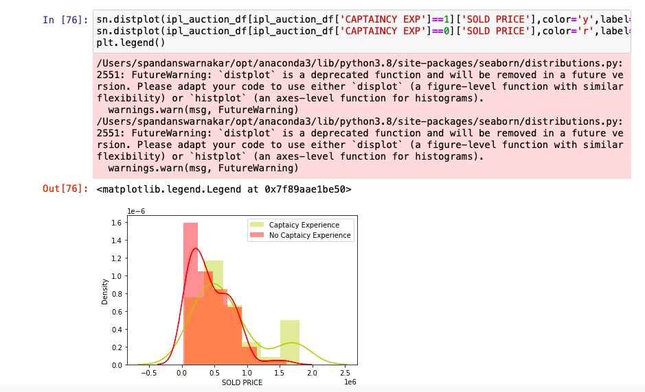
Analysis and Output(4/5)
Sold price profiling against Playing role
The median sold price for allrounders and batsmen are higher than bowlers and wicket keepers.
All-rounders who are paid more than 1350000 USD are not considered outliers.
All-rounders have relatively high variance. There are outliers in batsman and wicket keeper’s category.
It can be observed that players with captaincy that players with captaincy experience seem to be paid higher.
Sold Price Profiling with and without captain experience

Slide 7
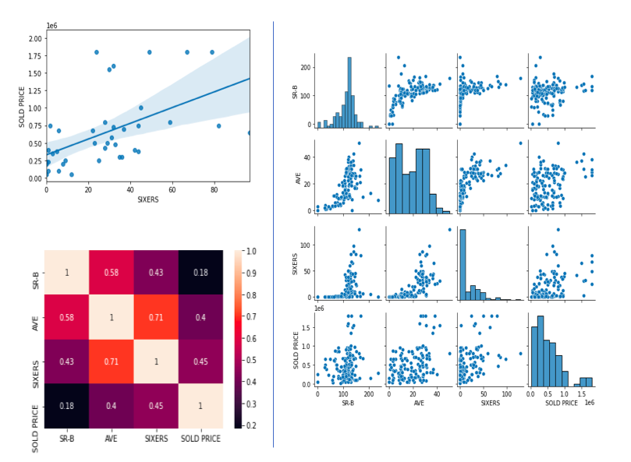
Analysis and Output(5/5)
The line shows there is a positive correlation between number of sixes hit by a batsman and the sold price.
The pair plot is showing the correlation and explore the relationship of four variables.
Heatmap shows that AVE and sixer show positive correlation while sold price and SR-B are not so strongly correlated.

Slide 8
Interpretation
We find 40% of the IPL players are from India which is evident because there are rules about the max. percentage of foreign players that can play.
Middle age group players are max that’s evident as low age players lack experience and aged players lacks stamina. The top players in terms of sold price are mostly batsman which signifies batsman are of high priority in IPL.
We observed that the batsman are paid maximum from age group 1 and 2 whereas allrounders are paid maximum in age category 3.This could be because allrounders establish the credentials as good allrounders over a period.
For all the correlations AVE and SIXERS seem to be highly correlated with SOLD PRICE compared to SR-B.
The correlation value lies between -1.0 and 1.0. -1.0 indicates a perfect negative correlation whereas +1.0 indicates perfect positive correlation. The heatmap shows that sixer show positive correlation while sold price and SR-B are not so strongly correlated. IPL is a game of entertainment and who can score at a faster pace so more sixers more entertainment so that’s why probably the players with highest number of sixes are sold at higher price.

Slide 9
Conclusion
The objective of descriptive analytics is simple comprehension of data using data summarization, basic statistical measures and visualization.
Pandas library provides excellent support for Data Frame and its operations. Operations like filtering , grouping , aggregations, sorting, joining and many more are readily available in this library.
Matplotlib and seaborn are two most widely used libraries for creating visualization.
Plots like histogram, distribution plots, box plots, scatter plots, pair plots, heatmap can be created to find insights during exploratory analysis.
After this modelling can be done to this dataset to predict selling price of players given certain features.

Slide 10
Thank You

